Slide 1
AWT Components & Event Handling Unit 4 & Unit 5

Slide 2
AWT Components
Button
Checkbox
Label
Choice
Scrollbar
List
TextArea
Button
Checkbox
CheckboxGroup

Slide 3
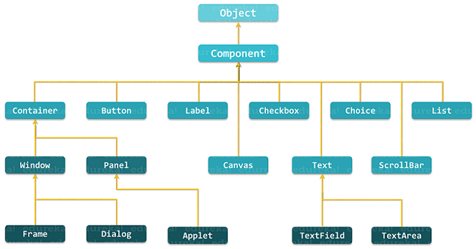
Hierarchy of Applet and AWT component classes

Slide 4
Container
The Container is a component in AWT that can contain another components like buttons, textfields, labels etc.
The classes that extends Container class are known as container such as Frame, Dialog, Panel and Applet.
Creating and adding Components :
Label lab = new Label ("Hi, I m Label");
add (lab); // same as this.add(lab);
Button but = new Button ("Click me!");
add (but);
Checkbox toggle = new Checkbox ("toggle");
add(toggle);
TextField txt = new TextField ("Initial text.", 20);
add(txt);

Slide 5
Common methods of Component class
Method | Description
void add(Component c) | inserts a component on this component.
void setSize(int width,int height) | sets the size (width and height) of the component.
Dimension getSize() | Returns the current size of this component.
void setLayout(LayoutManager m) | defines the layout manager for the component.
void setVisible(boolean status) | changes the visibility of the component, by default false.
void setBackground(Color c) | Sets the background color.
void setForeground(Color c) | Sets the foreground color.
void setFont(Font f) | Sets the font of the component.

Slide 6
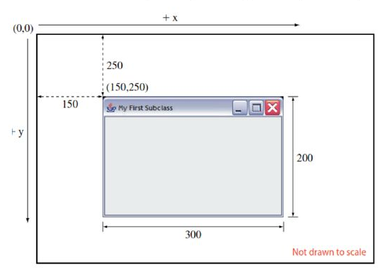
setBounds() method
In Java Graphical User Interface, the layout managers automatically decide the size and position of the newly added component.
In the absence of a layout manager, the position and size of the components have to be set manually.
The setBounds() method is used in such a situation to set the position and size.
To specify the position and size of the components manually, the layout manager of the frame can be null.
public void setBounds(int x, int y, int width, int height)

Slide 7
Label class
This class is a Component which displays a single line of text.
Labels are read-only. That is, the user cannot click on a label to edit the text it displays.
Text can be aligned within the label
Constructors are:
Label()
Label(String label)
Label(String label, int align) Label.LEFT,Label.RIGHT, Label.CENTER
(Default align is left)
Methods:
String getLabel()
void setLabel()
Ex: Label uname = new Label(“User Name");
add(uname);

Slide 8
Button class
This class represents a push-button with label.
Constructors:
Button( )
Button(String caption)
For ex:
Button okButton = new Button("Ok");
Button cancelButton = new Button("Cancel");
this.add(okButton));
this.add(cancelButton));

Slide 9
Checkbox class
This class represents a GUI checkbox with a label.
The Checkbox maintains a boolean state indicating whether it is checked or not.
If a Checkbox is added to a CheckBoxGroup, it will behave like a radio button.
Constructors are:
Checkbox()
Checkbox(String label)
Checkbox(String label, boolean on)
Checkbox(String label, boolean on, CheckboxGroup gr)
Checkbox(String label, CheckboxGroup gr ,boolean on)
Methods:
String getLabel() , void setLabel()
boolean getState(), void setState(boolean state)
Ex: Checkbox c1 = new Checkbox(“Music”, true)
add(c1)

Slide 10
Choice class
This class represents a dropdown list of Strings.
Only one item from the list can be selected at one time and the currently selected element is displayed.
Constructors: Choice()
Methods:
void add(String item)
void insert(String item, int index)
void remove(String item)
void remove(int position)
void removeAll()
String getSelectedItem()
int getSelectedIndex()

Slide 11
Choice class
For ex:
Choice ch = new Choice();
ch.add(“Java");
ch.add(“Oracle");
ch.add(“OS");
ch.add(“CG");
add(ch);

Slide 12
List class
This class is a Component which displays a list of Strings.
The list is scrollable, if necessary.
Sometimes called Listbox in other languages.
Lists can be set up to allow single or multiple selections.
The list will return an array indicating which Strings are selected
Constructors:
List()
List(int num)
List(int num, boolean multi)
Methods: String[] getSelectedItems(),
int[] getSelected Indexes()
Others are Similar as Choice class

Slide 13
List class
For example :
List l1 = new List(4,true);
l1.add(“JAVA");
l1.add(“PHP");
l1.add(“DS");
l1.add(“SAD");
add(l1);

Slide 14
TextField class
This class displays a single line of optionally editable text.
This is one of the most commonly used Components in the AWT
Constructors are:
TextField()
TextField(String str)
TextField(int numofchars)
TextField(String str, int numofchars)
Methods: getText(), setText(),
getSelectedText(), isEditable(), setEditable(), setEchoChar(), getEchochar(), echoCharIsSet()
Ex: TextField uname= new TextField(30);
add(uname);

Slide 15
TextArea class
This class displays multiple lines of optionally editable text.
TextArea has same methods as TextField class and also provides the methods:
append(), insert()
// 5 rows, 80 columns
TextArea ta = new TextArea(5, 80);
add(ta);

Slide 16
Scrollbar
The object of Scrollbar class is used to add horizontal and vertical scrollbar.
Scrollbar is a GUI component allows us to see invisible number of rows and columns.
Constructors :
Scrollbar() : Constructs a new vertical scroll bar.
Scrollbar (int orientation) : Constructs a new scroll bar with the specified orientation.
Scrollbar(int orientation, int value, int visible, int minimum, int maximum) : Constructs a new scroll bar with the specified orientation, initial value, visible amount, and minimum and maximum values.
Constants :
static int HORIZONTAL --A constant that indicates a horizontal scroll bar.
static int VERTICAL --A constant that indicates a vertical scroll bar.

Slide 17
Frame class
The Frame is the container that contain title bar and border and can have menu bars.
The Window class defines a top-level Window with no Borders or Menu bar.
Frame defines a top-level Window with Borders and a Menu Bar
Once defined, a Frame is a Container which can contain Components
Frame aFrame = new Frame(”Hello World”);
aFrame.setSize(100,100);
aFrame.setLocation(10,10);
aFrame.setVisible(true);

Slide 18
Panel
The Panel is a simplest container class.
It provides space in which an application can attach any other component.
It inherits the Container class.
It doesn't have title bar.
Using panels, you can design complex GUls.
Constructors :
Panel() : Creates a new panel using the default layout manager.
Panel(LayoutManager layout) : Creates a new panel with the specified layout manager.
Panel p = new Panel();
p. add (new Button (“OK”);
p.add(new Button(“Cancel”);
add(p)

Slide 19
Layout Manager
A layout manager determines how Components will be arranged when they are added to a container.
Default Layout of the Container is Flowlayout.
Java includes Bunch of General-purpose layout manager :-
FlowLayout
BorderLayout
GridLayout
GridBagLayout
CardLayout
GroupLayout
SpringLayout
BoxLayout

Slide 20
FlowLayout
FlowLayout is used to arrange components in a sequence one after the other.
The default layout of applet and panel is FlowLayout.
Flow layout puts components (such as text fields, buttons, labels etc) in a row, if horizontal space is not enough to hold all components then Flow layout adds them in a next row and so on.
Constructors :
FlowLayout(): creates a flow layout with centered alignment and a default 5 unit horizontal and vertical gap.
FlowLayout(int align): creates a flow layout with the given alignment and a default 5 unit horizontal and vertical gap.
FlowLayout(int align, int hgap, int vgap): creates a flow layout with the given alignment and the given horizontal and vertical gap.
Constants or Fields :
public static final int LEFT
public static final int RIGHT
public static final int CENTER
public static final int LEADING
public static final int TRAILING

Slide 21
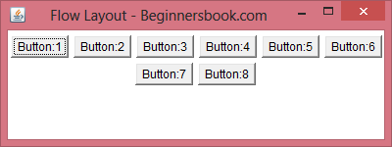
FlowLayout

Slide 22
BorderLayout
The BorderLayout is used to arrange the components in five regions: north, south, east, west, and center. Each region (area) may contain one component only.
It Divides the container into Five sections: north, south, east, west and center.
A BorderLayout is created with either the
BorderLayout( ) {without gap}
BorderLayout(int , int) {with horizontal and vertical gap}
After creating a border layout and set it up as a container’s layout manager, components are added using a call to the add( ) method.
Syntax:- add(component, String)

Slide 23
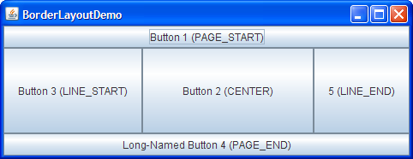
BorderLayout
The BorderLayout provides five constants for each region:
public static final int NORTH
public static final int SOUTH
public static final int EAST
public static final int WEST
public static final int CENTER

Slide 24
GridLayout
The GridLayout Class in the java.awt Package.
This layout manager can be used to stack component from top to bottom or left to right.
The GridLayout manager must be created with two arguments to its constructor:
The number of rows in grid and
The number of columns
Ex. GridLayout gr1=new GridLayout (10, 3);
Ex. GridLayout gr2=new GridLayout (10, 3, 5, 8);
Note:- Default gap between Component is 0 pixel in both vertical and horizontal direction.
row column Horizontal vertical gap gap

Slide 25
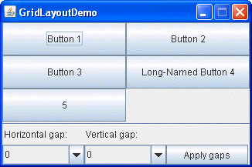
GridLayout

Slide 26
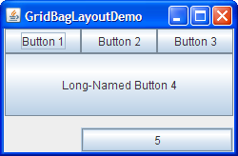
GridBagLayout

Slide 27
Event Handling Unit 5

Slide 28
What is Event ?
Change in the state of an object is known as event.
Events are generated as result of user interaction with the graphical user interface components.
For example, clicking on a button, moving the mouse, entering a character through keyboard,selecting an item from list, scrolling the page are the activities that causes an event to happen.
The source of an event is the component that causes that event to occur.
The listener of an event is an object that receives the event and processes it appropriately.

Slide 29
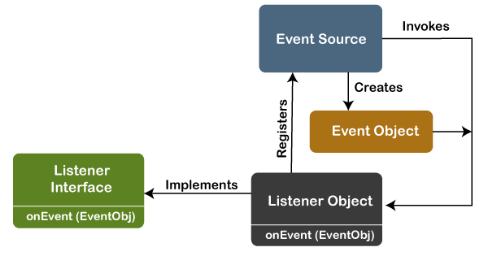
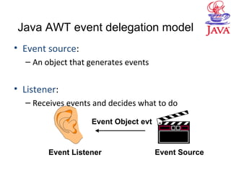
Event Handling : Event Delegation Model
Event handling in Java is the procedure that controls an event and performs appropriate action if it occurs. The code or set of instructions used to implement it is known as the Event handler.
It consists of two major components:
The event source
The event listener
The source is the object where the event occurs, and the event listener is responsible for taking appropriate actions when an event occurs. These Listeners must be registered with the source object in order for the listener to receive event notifications.

Slide 30
Event classes
AWTEvent class :
Subclass of EventObjcet class and member of java.awt package
Super class of all AWT events handled by event delegation model
EventObjcet | FocusEvent
AWTEvent | ItemEvent
ActionEvent | KeyEvent
AdjustmentEvent | MouseEvent
ComponentEvent | MouseWheelEvent
ContainerEvent | TextEvent
WindowEvent

Slide 31
Components and it’s event
Event Class | Description | Listener Interface
ActionEvent | generated when button is pressed, menu-item is selected, list-item is double clicked | ActionListener
MouseEvent | generated when mouse is dragged, moved,clicked,pressed or released also when the enters or exit a component | MouseListener
KeyEvent | generated when input is received from keyboard | KeyListener
ItemEvent | generated when check-box or list item is clicked | ItemListener
TextEvent | generated when value of textarea or textfield is changed | TextListener

Slide 32
Components and it’s event
Event | Description | Listener
WindowEvent | generated when window is activated, deactivated, deiconified, iconified, opened or closed | WindowListener
ComponentEvent | generated when component is hidden, moved, resized or set visible | ComponentEventListener
ContainerEvent | generated when component is added or removed from container | ContainerListener
AdjustmentEvent | generated when scroll bar is manipulated | AdjustmentListener
FocusEvent | generated when component gains or loses keyboard focus | FocusListener

Slide 33
Registration Methods
Button
public void addActionListener(ActionListener a){}
TextField
public void addActionListener(ActionListener a){}
public void addTextListener(TextListener a){}
TextArea
public void addTextListener(TextListener a){}
Checkbox
public void addItemListener(ItemListener a){}
Choice
public void addItemListener(ItemListener a){}
List
public void addActionListener(ActionListener a){}
public void addItemListener(ItemListener a){}

Slide 34
ActionEvent and ActionListener
Action event is probably the easiest and most common event handlers to implement.
Constructors of ActionEvent:
ActionEvent( Object Source, int type, String command)
ActionEvent( Object Source, int type, String command, int modifiers)
Methods of ActionEvent:
String getActionCommand()
int getModifiers()
Method of ActionListener
void actionPerformed(ActionEvent obj)

Slide 35
ItemEvent and ItemListener
Generated when a checkbox or list item is clicked
Constructor:
ItemEvent(Item source, int type, int state)
Constants:
SELECTED
DESELECTED
This class implements method:
void itemStateChanged(ItemEvent obj)

Slide 36
MouseEvent and MouseListener
Constants:
MOUSE_CLICKED
MOUSE_PRESSED
MOUSE_RELEASED
MOUSE_DRAGGED
MOUSE_ENTERED
MOUSE_EXITED
MOUSE_MOVED
Methods:
getX( ),getY( ), getClickCount( )
Methods of MouseListener
void mouseClicked(MouseEvent obj)
void mousePressed(MouseEvent obj)
void mouseReleased(MouseEvent obj)
void mouseEntered(MouseEvent obj)
void mouseExited(MouseEvent obj)
Methods of MouseMotionListener
void mouseMoved(MouseEvent obj)
void mouseDragged(MouseEvent obj)

Slide 37
KeyEvent and KeyListener
Event is generated when key is pressed of the keyboard
Constant:
KEY_PRESSED
KEY_RELEASED
KEY_TYPED
Methods of KeyListener:
void keyPressed(KeyEvent obj)
void keyReleased(KeyEvent obj)
void keyTyped(KeyEvent obj)

Slide 38
TextEvent and TextListener
Generated when user inputs text into TextField or TextArea
Constants:
TEXT_VALUE_CHANGED
Listener method:
void textValueChanged(TextEvent e)

Slide 39
WindowEvent and WindowListener
Handles events related to window
Constants:
WINDOW_ACTIVATED
WINDOW_DEACTIVATED
WINDOW_CLOSING
WINDOW_CLOSED
WINDOW_OPENED
WINDOW_GAINED_FOCUS
WINDOW_LOST_FOCUS
WINDOW_ICONIFIED (Minimize)
WINDOW_DEICONIFIED
WINDOW_STATE_CHANGED
Methods of listener is according to above constants

Slide 40
Methods of WindowListener
Sr. no. | Method signature | Description
1. | public abstract void windowActivated (WindowEvent e); | It is called when the Window is set to be an active Window.
2. | public abstract void windowClosed (WindowEvent e); | It is called when a window has been closed as the result of calling dispose on the window.
3. | public abstract void windowClosing (WindowEvent e); | It is called when the user attempts to close the window from the system menu of the window.
4. | public abstract void windowDeactivated (WindowEvent e); | It is called when a Window is not an active Window anymore.
5. | public abstract void windowDeiconified (WindowEvent e); | It is called when a window is changed from a minimized to a normal state.
6. | public abstract void windowIconified (WindowEvent e); | It is called when a window is changed from a normal to a minimized state.
7. | public abstract void windowOpened (WindowEvent e); | It is called when window is made visible for the first time.

Slide 41
FocusEvent and FocusListener
Generated component gets or lost focus.
Constants:
FOCUS_GAINED
FOCUS_LOST
Listener methods:
void focusGained(FocusEvent e)
void focusLost(FocusEvent e)

Slide 42
Adapter classes
Java adapter classes provide the default implementation of listener interfaces.
If you inherit the adapter class, you will not be forced to provide the implementation of all the methods of listener interfaces.
Adapter class | Listener interface
WindowAdapter | WindowListener
KeyAdapter | KeyListener
MouseAdapter | MouseListener
MouseMotionAdapter | MouseMotionListener
FocusAdapter | FocusListener
Thank you for your patience
Keep up!

Slide 43
Water
They should have water available and be able to serve themselves whenever they like.
A well hydrated brain benefits learning
Light
The lighting must be the right one, neither too bright nor too dim. It is recommended to have sunlight complemented by artificial light. And make sure that the blackboard layout does not cause any reflection according to the orientation of the light

Slide 44
Our physical surroundings
Water
Light
Temperature
Aromas
Color
Use of walls
Seating layout
Music / Sound / Noise
Positive messages
Emotions
Schedule

Slide 45
Water
They should have water available and be able to serve themselves whenever they like.
A well hydrated brain benefits learning
Light
The lighting must be the right one, neither too bright nor too dim. It is recommended to have sunlight complemented by artificial light. And make sure that the blackboard layout does not cause any reflection according to the orientation of the light

Slide 46
Use of walls in the classroom
Front wall
Side walls
Back wall
What you need your students to use constantly until they learn it. For example: the alphabet or multiplication tables
What they are learning during the current period (teaching unit/quarter). Ideally, there should be posters made by the students themselves
What they have already learned or had been learning in past units

Slide 47
Positive messages
Positive messages help the brain to create confidence and a growth mindset
You can out encouraging messages or motivational phrases on the threshold of the door when entering the classroom or behind it if you wish to close the door to give your class. They should be in a visible place
You can also place a message on each student's desk, sticking it there with transparent adhesive tape
If this student always sits in the same seat, you can personalise it. This will help each student to lower their defensive barriers and feel more at ease
You’re doing great!
Great effort!
Thank you for your patience
I believe in you
Congrats
Good job!
Keep up!

Slide 48
Thanks!
Any questions?
youremail@freepik.com
+34 654 321 432
yourwebsite.com
Please keep this slide for attribution

Slide 49
Resources
Did you like the resources on this template? Get them for free at our other websites:
Vectors
Mental health concept
Spiritual retreat poster and flyer event template design
Photos
Medium shot woman reading
Side view of female teacher during online class at desk

